Slide 1
Making this resource work for you
Prior to teaching this lesson, please refer to the ‘Unit Overview and Planning Document’.
Further guidance on planning Science Mastery lessons can be found in the detailed planning guidance document.
Refer to the ‘notes’ section on each slide for useful information, including suggested expositions, pedagogical content knowledge, suggested questions, answers and more. Consider using presenter mode so you can see this guidance throughout the lesson.
The introduction slides can be adapted to suit your teaching style and the needs of your class.
Before the lesson, adapt the fix-it slide to address any misconceptions identified in the previous lesson’s exit ticket.
Choose from the suggested activities to suit your class. The intention is not that you complete all of these, but that you select those which ones are most appropriate for your students. It may be appropriate to further adapt activities for your students.
These lessons are designed to occupy approximately 1 hour. To adapt for a shorter or longer lesson duration we advise you to adapt the activity section accordingly.
Please consider using the final slide to send feedback about this lesson or examples of PowerPoints that you have adapted to our design team. Your feedback is used to improve Science Mastery for all of our teachers and students. We appreciate all suggestions and comments.
Thank you for reading!
The Science Mastery Team

Slide 2
Prior Knowledge Review: Relative Formula Mass and Percentage by Mass
Answer the questions below.
State the chemical symbol for nitrogen.
State how many atoms of each different element are present in CaCO₃.
State where metals are found on the periodic table.
Explain the difference between an element and a compound.
State the mass number of oxygen.
N
1 calcium atom, 1 carbon atom and 3 oxygen atoms
On the left hand side.
An element is made of one type of atom but a compound is made from two or more types of atom (elements) chemically bonded together.
16
Notes:
Big idea: Reactions rearrange matter
Foundation: Define an atom.
Stretch: Define a molecule.
Answers:
Foundation: The smallest thing that can exist.
Stretch: A small group of non-metal atoms chemically bonded together. Can be an element or a compound.

Slide 3
Prior Knowledge Review: Relative Formula Mass and Percentage by Mass
Do Now:
State the chemical symbol for nitrogen.
State how many atoms of each different element are present in CaCO₃.
State where metals are found on the periodic table.
Explain the difference between an element and a compound.
State the mass number of oxygen.
Drill:
Calculate 65% of 120.
A sample is made up of 40 g of water and 12 g of sugar. Calculate the percentage of the sample that is sugar.
Write the chemical symbol for potassium.
Notes:
Drill answers:
0.65 x 120 = 78
12/(12+40) x 100 = 23.1 %
K

Slide 4
Prior Knowledge Review: Relative Formula Mass and Percentage by Mass
Read Now:
The relative atomic mass of an element is the average mass of the atoms in the element compared to the mass of carbon-12. This means that relative atomic mass takes into account the mass of different isotopes of an element and how much of each isotope exists. The relative formula mass is the sum of the relative atomic masses of the elements in a compound. This is calculated using the relative atomic mass of each element present and how many of each atom are present in an element or compound. The relative atomic mass is taken from the mass number on the periodic table. The relative atomic mass of hydrogen is 1 and the relative atomic mass of oxygen is 16. Water has the formula H₂O, so its relative formula mass is 18 because it has two hydrogen atoms and one oxygen atom.
Define relative atomic mass.
Explain what is meant by isotopes.
Define relative formula mass.
State the relative formula mass of water.
Explain where this number comes from.

Slide 5
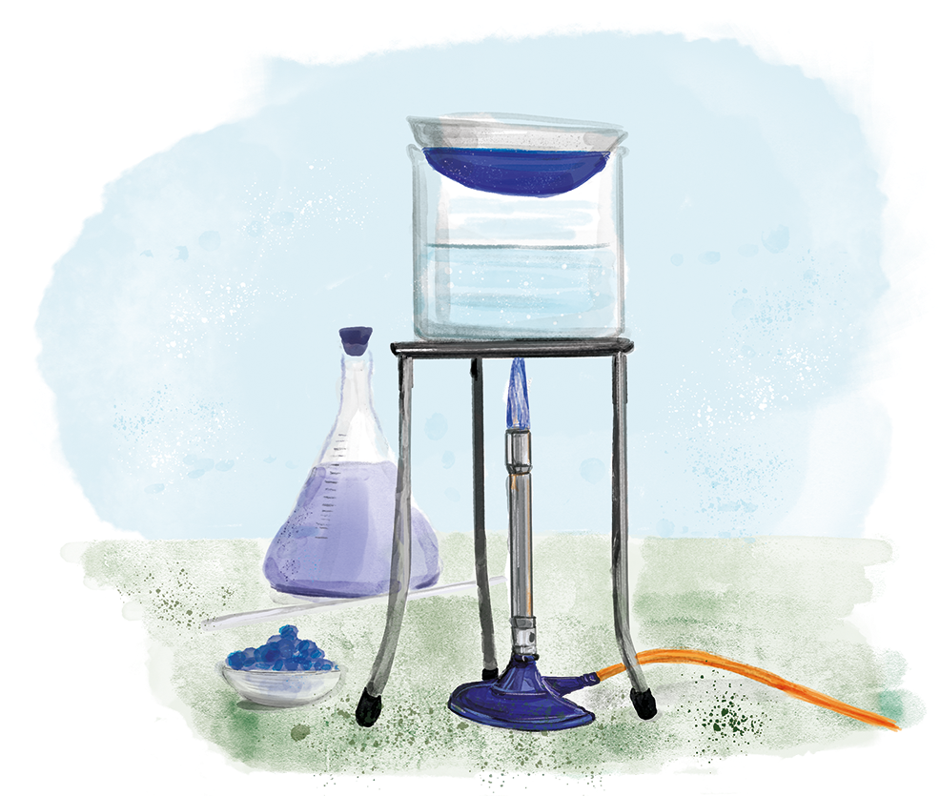
C4.3.1
03/12/2024
Prior Knowledge Review
Relative Formula Mass and Percentage by Mass
C4.3.1 Prior Knowledge Review
C4.3.2 Introducing the Mole
C4.3.3 Mole Calculations
C4.3.4 PKR: Concentration
C4.3.5 TIF: Calculating Concentration
C4.3.6 TIF: Calculating an Unknown Concentration
C4.3.7 (HT) Amounts of Substances in Equations
C4.3.8 (HT) Limiting Reactants
C4.3.9 PKR: Reactions of Acids
C4.3.10 Acids, Alkalis and Neutralisation
C4.3.11 TIF: Acid-Alkali Titration
C4.3.12 TIF: Acid-Alkali Titration Analysis
C4.3.13 TIF: Titration Calculations
C4.3.14 (HT) Strong and Weak Acids
C4.3.15 TIF: Volumes of Gases
Notes:
Big idea: Reactions rearrange matter
Suggested Hook:
What do the different numbers for each element represent on the periodic table? How do we use those numbers?

Slide 6

Following this lesson, students will be able to:
Define relative atomic mass and relative formula mass
Calculate relative formula mass
Calculate percentage by mass
Key Words:
relative atomic mass
relative formula mass
percentage by mass
Notes:
Guidance:
See unit overview document and planning guidance to see how these objectives are typically assessed at GCSE, including examples of what students should be able to do following this lesson.
Planning for different needs:
The learning objectives given on this slide are suggested based on the most common requirements for exams, however they can be adapted based on the needs of different classes.
For best practice, the unit preparation booklet should be used to determine the appropriate focus of lessons within the unit.
While it is not possible to explicitly split content into levelled grades, we recommend that lesson objectives can be classified as critical, core or stretch.
Critical: the content or skill is essential for all students to be able to progress.
Core: the content or skill is important for students to progress, but other opportunities may be available to revisit it.
Stretch: the content or skill may not be essential for all students but is important for students aiming for the highest grades.
Key skill: this is a crucial skill being developed in this unit as part of the skill mapping
C4.3.1 Lesson Objectives:
Critical: Define relative atomic mass and relative formula mass
Critical: Calculate relative formula mass
Critical: Calculate percentage by mass

Slide 7
This is the fix-it portion of the lesson
The fix-it is an opportunity to respond to gaps in knowledge, especially those identified by the pre-unit quiz.
The teacher should customise this slide as needed, to facilitate
reteach, explanation, demonstration or modelling of ideas and concepts that students have not yet grasped or have misunderstood.
practise answering specific questions or of key skills.
redrafting or improving previous work.
Notes:
Purpose: to spend time on any gaps identified in previous learning from pre-unit quiz.
Fix-it guidance can be found on the mark scheme for the pre-unit quiz.

Slide 8
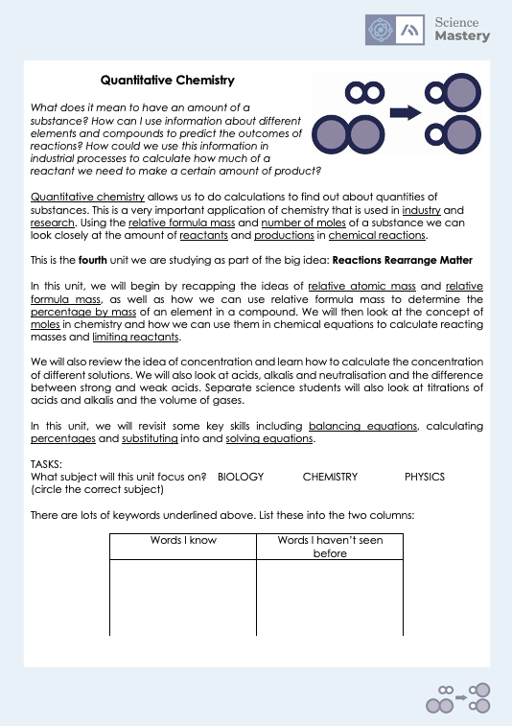
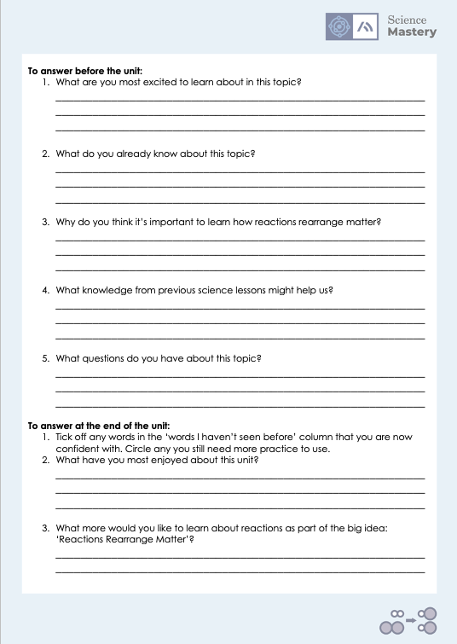
The Big Idea: Reactions rearrange matter
Notes:
Purpose:. The purpose of this resource is to provide students with an overview at the beginning and end of each unit. It is designed to create a discussion about the unit prior to the sequence of lessons.
Teacher guidance:
Pupils should be directed to the C4.3 Link to Big Ideas worksheet (either in their booklet or printed).
Teachers should use guided reading techniques to read aloud with the pupils. Tier 3 vocabulary has been highlighted. (It may need to be adapted further for LPAs or pupils with different reading ages.)
Questions on the student sheet:
1. What are you most excited to learn about in this topic?
2. What do you already know about this topic?
3. What is matter?
4. Why do you think it’s important to learn that ecosystems recycle resources?
5. What knowledge from previous science lessons might help us?
6. What questions do you have about this topic?
There are a range of ways to use this resource:
1. Display on a slide for students to read as a class. Direct students to complete the activities in their book.
2. Print off for students to stick into their book at the beginning of the unit along with their knowledge organiser. Complete as a guided reading task together. Direct students to complete the activities.
3. Have students complete as part of a booklet.
Set as a homework prior to a unit.
If you have any feedback about how this resource could be used/improved, please contact the science mastery team: sciencemastery@arkonline.org

Slide 9
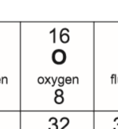
Relative means compared to something else
Relative Atomic Mass
Atoms are very small and have very little mass. So instead of using their actual mass in kg, their relative masses are used. This is the relative atomic mass or A_{r}.
The relative atomic mass of an element can be found in the periodic table.
Use a periodic table to find the A_{r} of carbon.
12
The relative atomic mass (A_{r}) is the average mass of the atoms of an element compared to the mass of carbon-12.
Notes:
Purpose: to introduce new learning.
Suggested script:
Atoms are so small, what would happen if I tried to find the mass of an atom using this balance? Show a regular balance you use in the lab. The reading would come up as zero.
So, when we want to be able to talk about the mass of atoms, it’s not very useful to use grams, or kilograms.
One carbon atom for example, would have a mass of 0.0000000000000000000000001994 g! (That’s 23 zeros). Imagine having to write numbers like that out every time we wanted to do a calculation with atoms!
Instead, we can make this much more simple by using what we call relative masses when we talk about atoms.
The word relative, in English, means compared to something else. For example I could say I’m quite tall relative to my cat. OR I could say I’m quite old relative to you. However, I’m not old at all relative to my grandmother!
When we talk about the relative atomic mass of an element, we are actually comparing the mass of the atoms in that element, to the mass of the atoms in other elements. To be really accurate, we would say we are comparing the mass of the atoms in the elements to the mass of a carbon atom.
Let’s take an example. Lithium atoms have half of the mass of nitrogen atoms. Lithium atoms have a relative atomic mass of 7, and nitrogen atoms have a relative atomic mass of 14.
Where do you think we might find out what the mass of each type of atom is? The Periodic Table.
I mentioned just now that the relative atomic mass of a lithium atom is 7. See if you can use your Periodic Table to locate that information. Give students time to locate lithium, and its mass number.
The relative atomic mass of any element can be located on the Periodic Table. It will always be the bigger number next to that element.
Take some time to spot check that all students can find the relative atomic mass of an element by asking students to find it for an element and then write down the answer on a mini whiteboard and holding up. Repeat this exercise until all students are able to do this.
We can also use A_{r} to mean relative atomic mass. Dual code this on the board.
A_{r} means exactly the same as relative atomic mass. The r is a subscript. Can you remember what subscript means? It means the r is slightly lower down that the other letter.
Let’s make a link back to the previous chemistry unit we studied here. We’re talking about the mass of atoms. Where in the atom is most of this mass located? The nucleus.
Why is this? Because the nucleus is where the protons and neutrons are located, and each of these have a relative mass of 1. The electrons are orbiting the nucleus and these have a mass of almost zero.
Teacher guidance:
Relative molecular mass has the same symbol (Mr) but only applies to substances with covalent bonds. Relative formula mass includes everything. So it is recommended to ONLY use RFM not RMM. For more information take a look at https://www.chemguideforcie.co.uk/section1/learninga.html

Slide 10
State the relative atomic mass (A_{r}) for the following elements.
Potassium
Iron
Neon
Hydrogen
Gold
Sulfur
Helium
Magnesium
Carbon
39
56
20
1
197
32
4
24
12
You’ll need your Periodic Table for this!
Notes:
Teacher guidance:
Try out one or two of these with your class at first to check understanding. If the class has grasped this knowledge quickly, it may not be necessary for them to spend time completing all of the questions on this slide. Instead, spend more time on relative formula mass coming up on the next slide.

Slide 11
Relative Formula Mass
For compounds (different elements combined together chemically) we can calculate the relative formula mass or M_{r}.
This is calculated by adding up the relative atomic masses of the all the atoms in the formula.
CO₂ contains 1 carbon atom and 2 oxygen atoms.
A_{r}: C = 12
O = 16
To calculate the M_{r}:
M_{r} of CO₂ = 12 + (2 x 16) = 44
The relative formula mass (M_{r}) is the sum of the relative atomic masses of the elements in a compound.
Notes:
To accompany this slide, the teacher could make some examples of molecules using molymods and ask students to calculate the RFM of each. This will allow students to see what the calculation actually means.

Slide 12
Calculating relative formula mass
Steps:
1. Write out the elements and their relative atomic masses
Magnesium nitrate, Mg(NO₃)₂
Mg is Magnesium, 24
N is Nitrogen, 14
O is Oxygen, 16
2. Use the formula to write the number of atoms of each element
Magnesium: 1
Nitrogen: 2
Oxygen: 6
3. Calculate the mass of the atoms of each element (Relative atomic mass x number of atoms)
Magnesium: 24 x 1 = 24
Nitrogen: 14 x 2 = 28
Oxygen: 16 x 6 = 96
4. Add up the total mass of the elements (this is your M_{r})
24 + 28 + 96 = 148
Notes:
Exposition type: Modelling

Slide 13
Calculating relative formula mass
Steps:
1. Write out the elements and their relative atomic masses
Calcium carbonate, CaCO₃
Ca is Calcium, 40
C is Carbon, 12
O is Oxygen, 16
2. Use the formula to write the number of atoms of each element
Calcium: 1
Carbon: 1
Oxygen: 3
3. Calculate the mass of the atoms of each element (Relative atomic mass x number of atoms)
Calcium: 40 x 1 = 40
Carbon: 12 x 1 = 12
Oxygen: 16 x 3 = 48
4. Add up the total mass of the elements (this is your M_{r})
40 + 12 + 48 = 100
Notes:
Exposition type: Modelling

Slide 14
Calculating the relative formula mass (M_{r})
Calculate the M_{r} for the following compounds.
(A_{r}: H = 1; C = 12; N = 14; O = 16; K = 39)
NH₃
O₂
H₂O
KOH
Use your understanding of the conservation of mass to find the M_{r} of CaO. (M_{r}: CaCO₃ = 100; CO₂ = 44)
CaCO₃ → CaO + CO₂
100 ? 44
100 – 44 = 56
100 = 56 + 44
14 + (1 x 3) = 17
16 x 2 = 32
(1 x 2) + 16 = 18
39 + 16 + 1 = 56
Notes:
Purpose: to check that key knowledge from the introduce phase has been learnt and understood.

Slide 15
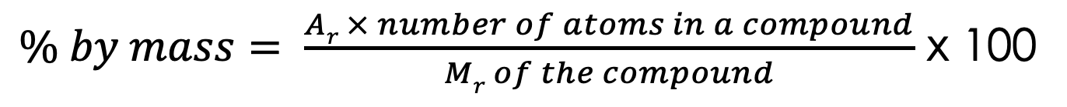
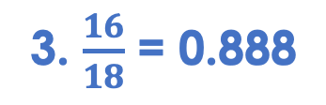
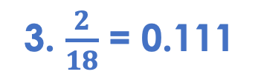
Percentage by mass
Percentage by mass is used to calculate the percentage by mass of an element within a compound
$\% by mass= \frac{Ar × number of atoms in a compound}{Mr of the compound}$ x 100
What is the Percentage by mass of hydrogen in water (H₂O)?
What is the Percentage by mass of oxygen in water (H₂O)?
Steps:
1. Find the A_{r} and count the number of each type of atom.
1. A_{r} of hydrogen = 1
1. A_{r} of oxygen = 16
2. Find the M_{r}
Number of hydrogen atoms = 2
Number of oxygen atoms = 1
3. Divide the sum of the relative atomic masses of all atoms you are investigating by the relative formula mass
2. M_{r} of H₂O =18
2. M_{r} of H₂O =18
3. $\frac{2}{18}$ = 0.111
3. $\frac{16}{18}$ = 0.888
4. 0.111 x 100 = 11.11%
4. Multiply by 100
4. 0.888 x 100 = 88.8%
Notes:
Suggested script:
Percentage by mass is exactly what it sounds like. When you think of a compound, made up of different types of atom, each atom will have a different mass, and those masses added together make up the total mass of the compound. Like water, contains hydrogen atoms and an oxygen atom. Dual code on the board the formula for water and draw a simple molecule with 2 x hydrogen atoms bonded to an oxygen atom in a V shape.
We can use a percentage by mass calculation to figure out what percentage of the total mass comes from a single element or group of atoms. So thinking about water, we can check what percentage of the mass of that compound is hydrogen atoms, and what percentage is the oxygen atom. Is the hydrogen contributing 50% of the mass? 10%? 90% who knows?!
So, read definition, percentage by mass is used to calculate the percentage by mass of an element within a compound.
How can we find this out? Well, we use a formula which looks like this. animate formula.
What is this formula telling us? To calculate the percentage by mass, we should multiply the relative atomic mass of an element by the number of atoms of that element in a compound. Then divide by the relative formula mass of the compound. Then multiple by 100.
Lets look at this in practice. What is the percentage by mass of hydrogen in water, H₂O?
animate to reveal the steps one by one with the worked example.
This can also be called a ‘percentage composition’ calculation.
Repeat this process with the second calculation worked out on the slide.
Repeat on the whiteboard with other simple compounds as necessary for students to grasp this method, and then give students an opportunity to try this independently. You can also ask students to work it out in pairs before trying independently.

Slide 16

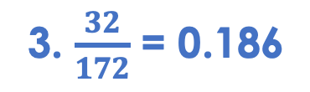
Percentage by mass
The chemical octyl acetate smells like oranges.
It has the formula C₁₀H₂₀O_{2.}
Calculate the percentage by mass of oxygen in octyl acetate.
1. A_{r} of oxygen = 16
Number of oxygen atoms = 2
2. M_{r} of C₁₀H₂₀O₂ = 172
3. $\frac{32}{172}$ = 0.186
4. 0.186 x 100 = 18.6%
Notes:
Image source: Pixabay

Slide 17
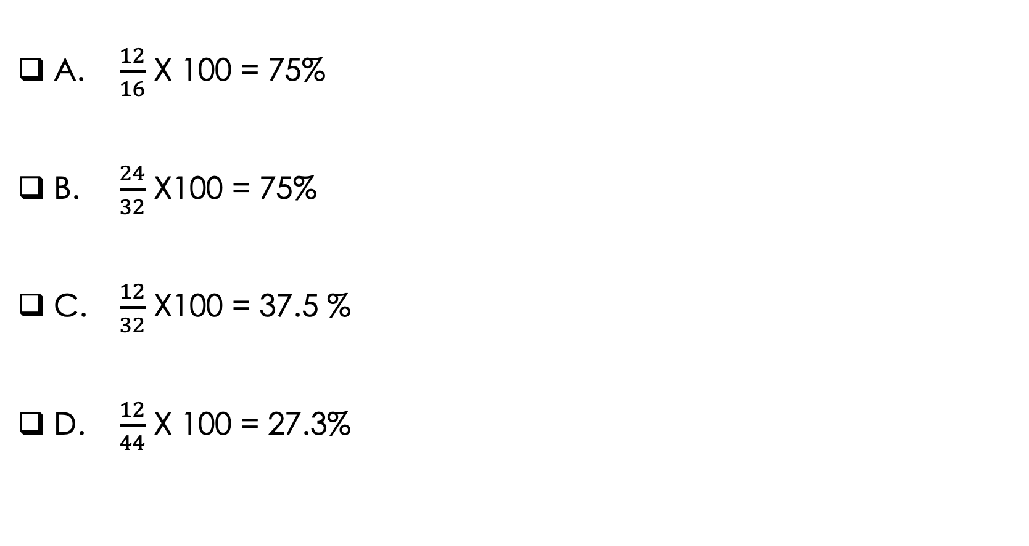
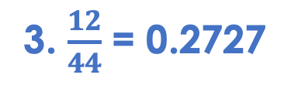
What is the percentage by mass of carbon in CO₂?
A. $\frac{12}{16}$ X 100 = 75%
B. $\frac{24}{32}$ X100 = 75%
C. $\frac{12}{32}$ X100 = 37.5 %
D. $\frac{12}{44}$ X 100 = 27.3%
1. A_{r} of carbon = 12
Number of carbon atoms = 1
2. M_{r} of CO₂ =44
3. $\frac{12}{44}$ = 0.2727
✓
4. 0.2727 x 100 = 27.3%

Slide 18

What is the difference between these two terms?
A_{r}
M_{r}
Notes:
Suggested guidance:
Talk tasks can be used in a variety of ways to suit the particular needs of the students you are teaching. Through exchanging views with others, students develop their understanding of the science beyond what could be achieved individually.
Science classrooms that successfully integrate talk have the following features:
Science talk is a regular feature of lessons and is woven into classroom activities.
Students are paired or grouped strategically by the teacher to ensure productive interaction. This might take into consideration the students’ proficiency of the English language, how encouraging they might be to peers and their attainment in the topic. It’s a good idea to consider these pairings in the class seating plan.
Students are encouraged and supported to talk, but are not forced to talk.
The teacher should take on the role of a facilitator, engaging with conversations where necessary and encouraging or steering the conversation where needed.
Students are encouraged to use the language they have to express their ideas (e.g., everyday language, imperfect English, native language), but also to incorporate science specific terminology where this is more accurate or has been taught.
6. Scientifically inaccurate ideas are not dismissed by the partner or teacher; open discussion and further investigation are relied on to help students construct ideas that support them to progress in their scientific understanding.
7. Guidelines for behaviour during talk tasks are explicit and frequently reviewed. Rules for students might be:
Listen carefully to your partner
Take turns talking.
Speak one at a time, without interrupting.
Politely agree or disagree and explain why.
Politely point out if your partner has used a scientific word incorrectly, if they have explained the science incorrectly, or if there is a more accurate way to describe something.
If confused, ask questions.
Stay focused on the discussion topic.
Respond to one another.

Slide 19
Which of these compounds contain a greater percentage of oxygen?
CaCO₃
H₂O
Notes:
Suggested guidance:
Talk tasks can be used in a variety of ways to suit the particular needs of the students you are teaching. Through exchanging views with others, students develop their understanding of the science beyond what could be achieved individually.
Science classrooms that successfully integrate talk have the following features:
Science talk is a regular feature of lessons and is woven into classroom activities.
Students are paired or grouped strategically by the teacher to ensure productive interaction. This might take into consideration the students’ proficiency of the English language, how encouraging they might be to peers and their attainment in the topic. It’s a good idea to consider these pairings in the class seating plan.
Students are encouraged and supported to talk, but are not forced to talk.
The teacher should take on the role of a facilitator, engaging with conversations where necessary and encouraging or steering the conversation where needed.
Students are encouraged to use the language they have to express their ideas (e.g., everyday language, imperfect English, native language), but also to incorporate science specific terminology where this is more accurate or has been taught.
6. Scientifically inaccurate ideas are not dismissed by the partner or teacher; open discussion and further investigation are relied on to help students construct ideas that support them to progress in their scientific understanding.
7. Guidelines for behaviour during talk tasks are explicit and frequently reviewed. Rules for students might be:
Listen carefully to your partner
Take turns talking.
Speak one at a time, without interrupting.
Politely agree or disagree and explain why.
Politely point out if your partner has used a scientific word incorrectly, if they have explained the science incorrectly, or if there is a more accurate way to describe something.
If confused, ask questions.
Stay focused on the discussion topic.
Respond to one another.

Slide 20
Drill
Define relative atomic mass.
State the relative atomic mass of carbon.
State the relative atomic mass of oxygen.
Define relative formula mass.
Calculate the relative formula mass of CO₂.
Calculate the relative formula mass of KOH.
State the equation to calculate percentage by mass.
Calculate the percentage by mass of potassium in potassium hydroxide (KOH).
Calculate the percentage by mass of chlorine in calcium chloride (CaCl₂).
Notes:
Purpose: This is a knowledge drill. The purpose of this is to check that the critical knowledge is secure before pupils move onto independent practice.
Suggested guidance: There are a range of ways this could be done depending on time and ability range of the class:
Mini whiteboards
As full sentences in exercise books
As short answers in exercise books
In the pupil workbook
As pair talk
As cold call

Slide 21
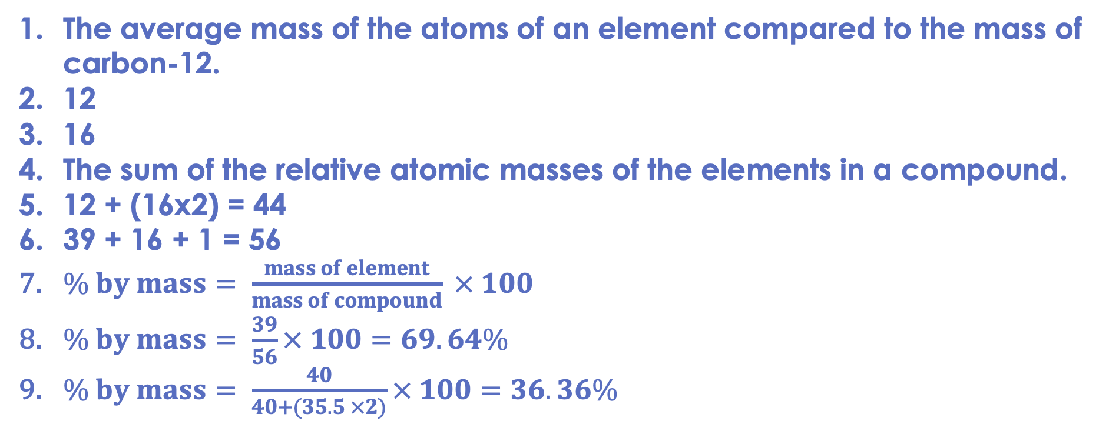
Drill answers
The average mass of the atoms of an element compared to the mass of carbon-12.
12
16
The sum of the relative atomic masses of the elements in a compound.
12 + (16x2) = 44
39 + 16 + 1 = 56
$\% by mass= \frac{mass of element}{mass of compound} × 100$
$\% by mass= \frac{39}{56}× 100=69.64\%$
$\% by mass= \frac{40}{40+(35.5 ×2)}× 100=36.36\%$
Notes:
Purpose: This is a knowledge drill. The purpose of this is to check that the critical knowledge is secure before pupils move onto independent practice.
Suggested guidance: There are a range of ways this could be done depending on time and ability range of the class:
Mini whiteboards
As full sentences in exercise books
As short answers in exercise books
In the pupil workbook
As pair talk
As cold call

Slide 22
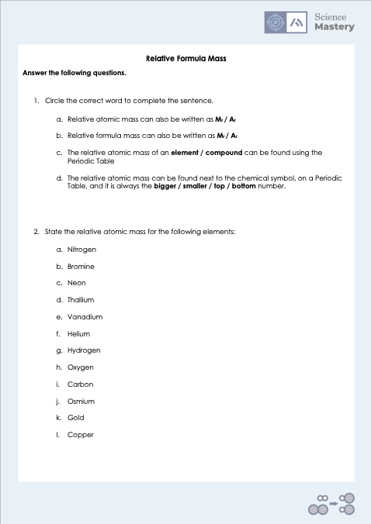
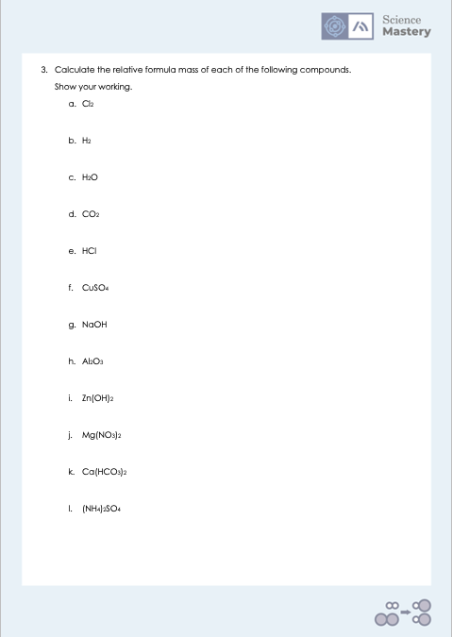
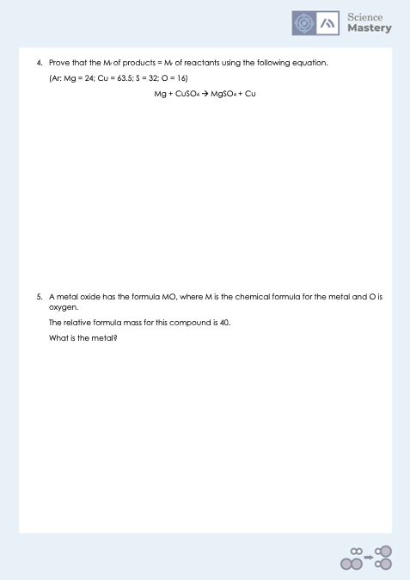
Activity
Notes:
Answers on word documents.

Slide 23
Answers
1a. A_{r}
3a. 71
4.
29 + 159.5 = 120 + 63.5
Both sides = 183.5
1b. M_{r}
3b. 2
1c. element
3c. 18
1d. bigger
3d. 44
3e. 36.5
5.
A_{r} of M + Mr of O = 40
A_{r} of M + 16 = 40
A_{r} of M = 24
M = Magnesium
2a. 14
3f. 159.5
2b. 80
3g.40
2c. 20
3h. 102
2d. 204
3i.99
2e. 51
3j. 148
2f. 4
3k.162
2g.1
3l. 132
2h. 16
2i.12
2j. 190
2k.197
2l. 63.5

Slide 24
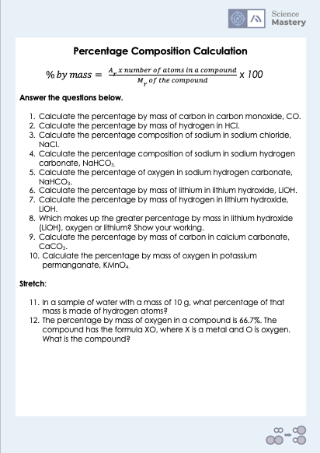
Activity

Slide 25
Answers
1. 75%
2. 2.7%
3. 39.3%
4. 27.3%
5. 57.1%
6. 29.1%
7. 4.1%
8. Oxygen, 66.7%
9. 12%
10. 40.5%
11. 11.1%
12. MgO

Slide 26
Answer the questions below.
Choose the correct definition of relative formula mass.
A. The average mass of atoms of an element compared to the mass of Carbon-12
B. The sum of relative atomic masses in a compound
C. The percentage of a compound is made of a particular element
✓
2. Calculate the relative formula mass of carbon dioxide (CO₂).
C = 12, O = 16
A. 28
B. 44
C. 56
✓
Calculate the percentage by mass of oxygen in carbon dioxide.
A. 27.27%
B. 36.36%
C. 72.72 %
✓
Notes:
Q1. Answer: B
If students answer A, they have confused Ar and Mr. To fix it, get students to write the definition of each and explain the difference between them. If students answer C, they have confused Mr and percentage by mass. To fix-it, review the definition of each with a model calculation.
Q2. Answer: B
If students answer A, they have just added the Ar of carbon and oxygen together without taking into account that there are two oxygen atoms. If students answer C, they have misinterpreted the meaning of the subscript and taken this to mean that there are two carbons and two oxygens. To fix-it, give students further practice of identifying the number of atoms of different elements in chemical formulae and calculating Mr.
Q3. Answer: C
If students answer A, they have calculated the percentage by mass of carbon. If students answer B, they have only used the Ar of oxygen and not taken the two oxygens into account. To fix-it, give students lots of practice with percentage by mass calculations.

Slide 27
Lesson C4.3.1
What was good about this lesson? | What can we do to improve this lesson?
Send us your feedback by clicking this link
or by emailing sciencemastery@arkonline.org
Thank you!

